Slide 1
An InTro to WileyPlus
PHYS 2C – Hirsch
T/R 3:30pm York 2722
by Signe Laundrup, WileyPLUS student partner
(edited by Jorge E. Hirsch (JEH))

Slide 2
What is WileyPlus?
WileyPLUS is an online learning platform that aims to help students learn.
It offers practice questions and assessments.
ORION adaptive practice aims to personalize the student’s learning experience, aims to help you to know what you don’t know.
Instructor (JEH) encourages you to explore it and feel free to use it or not.
NOTE: you may try it for free for 14 days, beyond that you need to purchase it for $49. Instructions for this in the next slides.

Slide 3
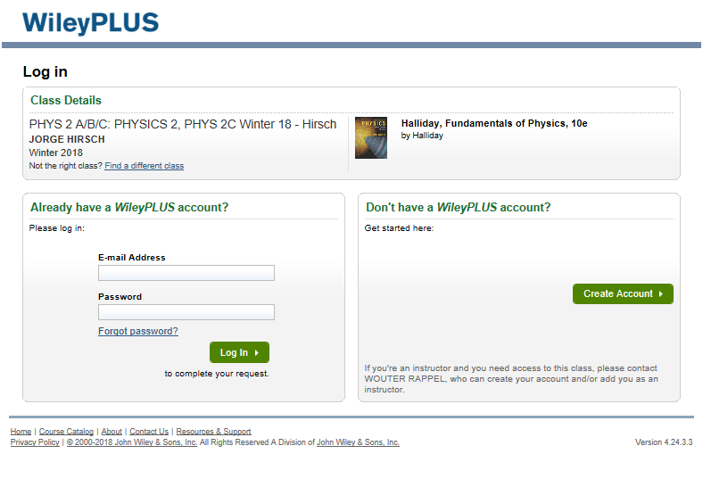
Create An Account Or link it
Get to your class section by going to this link: www.wileyplus.com/class/613398
Pick the option that applies to you.

Slide 4
…….

Slide 5
PURCHASING OPTIONS
Note: at the bottom of the page it should give you the option
to try it for up to 14 days before paying:
In this class you have a promo code (UCS63) you can use to get a major discount on the price ($49 instead of $140). To access it you need to click the “Online Only” option otherwise your promo code will not work

Slide 6
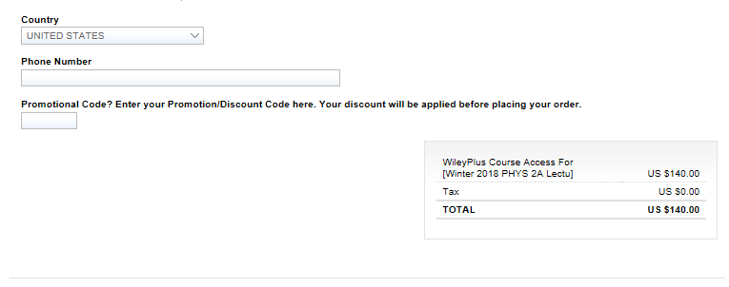
Creating Account (If you don’t have one)
Create your account and billing info by filling in required boxes. Don’t forget to insert your promo code: UCS63
Note that the billing information will still say that you owe $140 because the code has not been processed yet. DON’T PANIC, it will show up in the next parts.
YOUR PROMO CODE: UCS63

Slide 7
Billing
On the following page it will ask for your credit card information (to your left)
On the next page it will ask for verification. This is when the discount will kick in (the screenshot below) If you do not see the discount happen here, you should go back and make sure that you put in the promo code properly. Then confirm
TADAA!!!! You now should have access to your course

Slide 8
NAVIGATING WILEYPLUS

Slide 9
Reading the Book

Slide 10
DOING THE HOMEWORK
(This may not work (JEH))

Slide 11
WHAT IS ORION?

Slide 12
Please note: this is marketing material by WILEY
that may not have been Independently verified (JEH)

Slide 13
QUestionS?
Email me at signe.wileyplusstudentpartner@gmail.com I will try to get back to you within a couple hours (on weekends it may take longer).
Come to my office hours: Monday/Wednesday/Friday from 2-3 , on the second floor of Geisel Library (go right at the entrance) I will try to be at one of the tables close to the door. I will host these until the end of Week 2. If these times don’t work, you can email me and we can set up an appointment

Slide 14
THANKS! ☺

