Slide 1
Cyclotron Resonance and Faraday Rotation in infrared spectroscopy
PHYS 211A
Yinming Shao

Slide 2
Outline
Cyclotron resonance
Application in Ge: determing effective mass
Experimental detection of cyclotron resonance using FTIR
Faraday Rotation
General expression
Experimental detection
Giant Faraday Rotation in Graphene

Slide 3
Cyclotron resonance
Apply oscillating in-plane E-field
Charges can resonantly absorb energy from E-field
Resonance condition
$$ω=ω_{c}=\frac{eB}{m_{c}}$$
Typically changing B field around resonance
B
+ e
- e
q
Using microwaves as
AC E-field
G. Dresselhaus et al., Phys. Rev. 98, 368 (1955)
Notes:
Charge carriers will do cyclotron motion when magnetic field is present

Slide 4
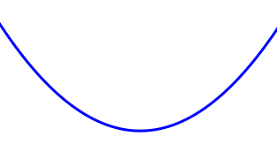
A word on different masses
Resonance condition $ω=ω_{c}=\frac{eB}{m_{c}}$
$m_{c}$ is the cyclotron mass :
S is the
k-space area of cyclotron orbits
Effective mass:
Parabolic bands:
Graphene:
$m^{∗}$ vanishes
$m_{c}$ exists!
$$m_{c}=m^{∗}$$

Slide 5
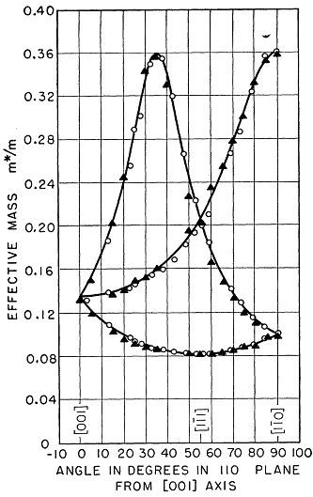
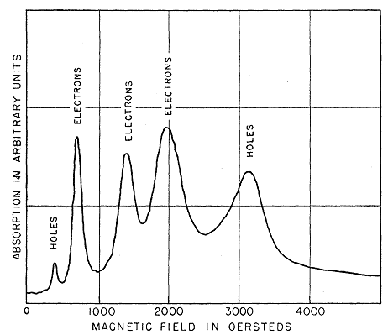
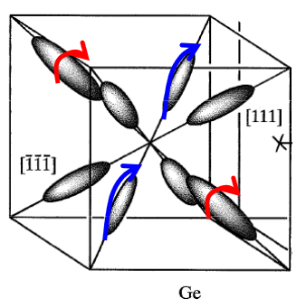
Cyclotron Resonance (CR) in Ge
In general, effective mass are anisotropic,
For Ge, constant energy surfaces near band edge are spheroidal
$$m_{t }$$
$$m_{l }$$
Measuring CR at different field angles $θ$
2. Extract cyclotron mass by $ω_{c}=\frac{eB}{m_{c}}$
G. Dresselhaus et al., Phys. Rev. 98, 368 (1955)

Slide 6
Condition to observe cyclotron resonance
For 1 T field,
Requires $μ>1\frac{m^{2}}{Vs}=10000\frac{{cm}^{2}}{Vs}$
Carrier mobility: $μ=\frac{eτ}{m^{∗}}$
Need high purity samples to see CR!!
Ge is the first high purity sample
people could obtain in ~1945
Organic semiconductors for CR??
Long way…
Metals have high conductivities and
E-field cannot penetrate sample→ requires special geometry
Commercial superconducting magnet → ~10 T B-field in lab accessible (~late 60s)
Resonance condition is easier to realize in
THz (${10}^{12}$ Hz) and far-infrared frequencies.
(FFT algorithm become popular after ~1965)
Use FTIR based
transmission to see CR

Slide 7
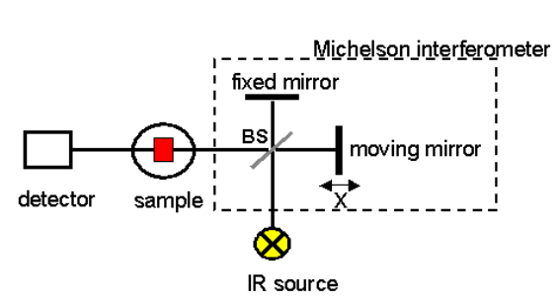
Fourier Transform InfraRed Spectroscopy (FTIR)
Transmission
set-up
Based on a two-beam Michelson Interferometer:
Infrared source→ broad band light source
Beam-splitter→ divides the beam to two with similar intensity
Fixed mirror, moving mirror → change the optical path difference
→ interferogram
Fourier transform the $I\left(x\right)$ to get the spectrum $I\left(ω\right)$

Slide 8
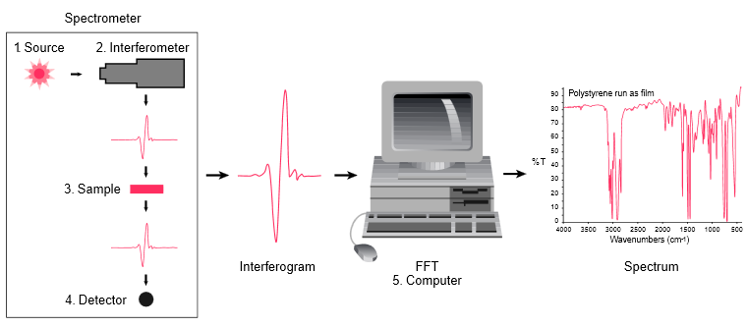
Fourier Transform InfraRed Spectroscopy (FTIR)
Advantage:
1. Fast: obtain transmittance/reflectance spectrum over a broad frequency range rapidly
Simple: moving mirror is the only moving part in the system
Sensitive: bright light source; average multiple scans is fast
http://mmrc.caltech.edu/FTIR/FTIRintro.pdf

Slide 9
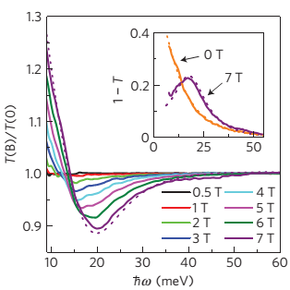
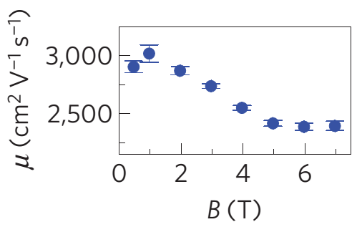
CR in graphene from transmittance measurements
Transmission data normalized by 0T data
→ Cancel out features that are not field dependent
Power absorption:
It can be shown that the Half Width at Half
Maximum is about the scattering rate $\frac{1}{τ}$.
Recall that $ω_{c}τ=μB$, by fitting the
cyclotron frequency one get estimates about
Carrier mobility.
Estimate mobility
Contact free!
$$μB≈0.3 @1T$$
$$μB≈1.5 @7T$$
I. Crassee et al, Nat Phys 7, 48 (2011)

Slide 10
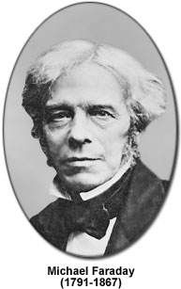
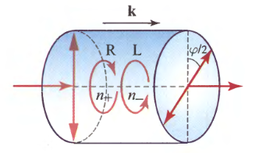
Magneto-Optical Faraday Effect
First observation (in 1845) of
light-magnetism interaction!
Optically active material: $n_{o}≠n_{e}$
Field induced circular birefringence $n_{−}≠n_{+}$
For linearly polarized light, the polarization
plane of the transmitted light is rotated
Notes:
Some nature material

Slide 11
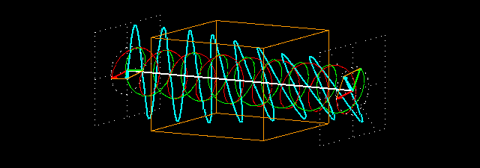
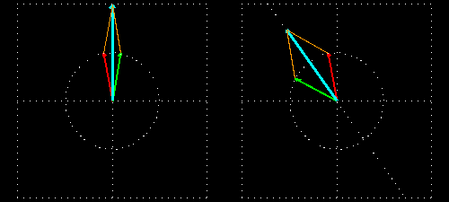
Faraday rotation $n_{−}≠n_{+}$
Complex refractive index
$$\tilde{N}=n+ik$$
$$n_{±}=\frac{c}{v_{±}}$$
Circular Birefringence
left- and right-handed light
travel at different
speeds in the medium
http://cddemo.szialab.org/

Slide 12
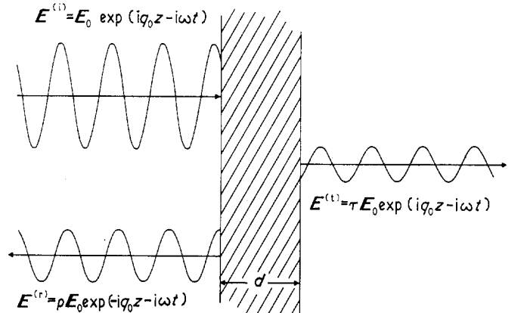
General expression of Faraday rotation angle: Single passage approximation
Complex transmission:
Need Relatively thick sample
to suppress multiple reflection
Faraday rotation:

Slide 13
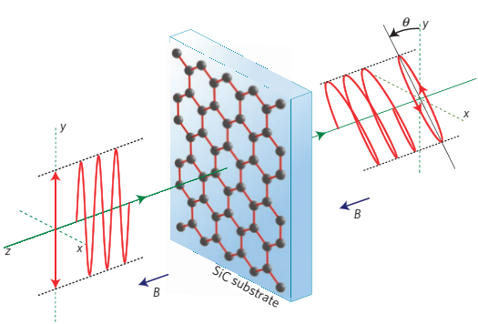
Detecting Giant Faraday rotation using crossed polarizers
The most straightforward method
Rotate the analyzer from 0 to 180 and then
Fit the transmitted intensity with $\cos^{2}(θ−θ_{F})$
Analyzer
Polarizer
Combine with FTIR
Faraday rotation $θ_{F}(ω)$
at different frequencies $ω$

Slide 14
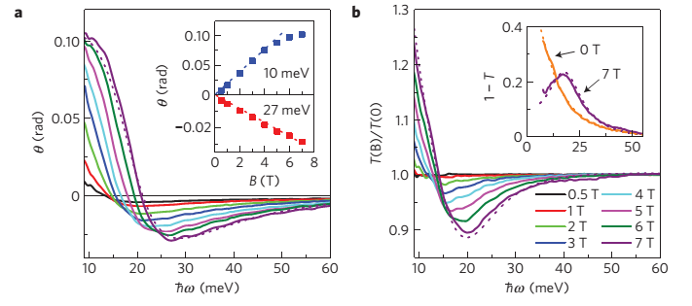
Giant Faraday rotation in graphene (on SiC)
1 atomic layer ($\sim {10}^{−10} m$)
→ > 6 degrees of polarization change!
Definitely Giant
Typical semiconductors (e.g. InSb)
comparable rotation but several
magnitudes thicker ($μm$)
$$ω_{c}=\frac{eB}{m_{c}}=\left\{\begin{aligned}>0 electron \\ <0 holes\end{aligned}\right.$$
is maximized around $ω_{c}$
Negative slope → hole doping!
Sign of
Matches the sign of $ω_{c}$
I. Crassee et al, Nat Phys 7, 48 (2011)

Slide 15
Some modeling based on Drude model
Equation of motion:
Solve v in terms of E and B then compared to
Current density $J=−nev=σE$
Assuming an harmonically varying field:
$E=E_{0}e^{−iωt}$ and therefore drift velocity
EOM becomes:
Dynamical conductivity (magnetic field introduces anisotropy)

Slide 16
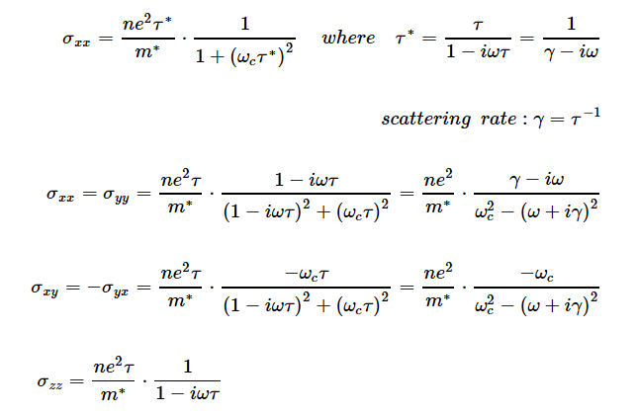
Explicit form of dynamical conductivity
$σ_{xx}:$
even function of $ω_{c}$
$σ_{xy}:$
odd function of $ω_{c}$

Slide 17
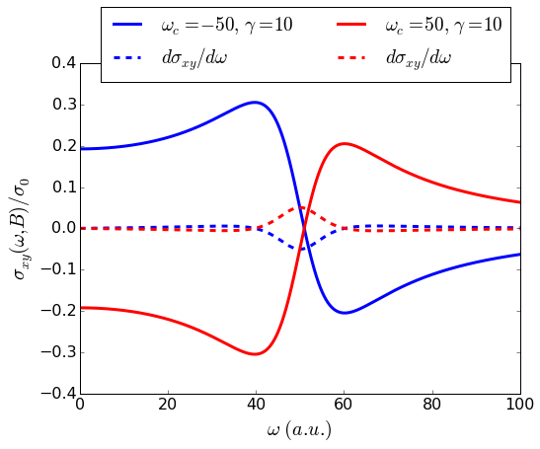
Modeling off-diagonal conductivity
Modeling graphene as a two dimensional
electron gas, its Faraday rotation angle $θ_{F}$
Is proportional to Re($σ_{xy}$) up to some positive
constant
Real part
1. Real part of $σ_{xy}$ ($θ_{F}$) is maximized
around cyclotron frequency.
Its derivative is maximized at $ω=ω_{c}$
Real part of $σ_{xy}$ ($θ_{F}$) changes sign
around cyclotron frequency.
Its derivative around $ω=ω_{c}$ matches the
sign of $ω_{c}$
gives information about the carrier type!
→ Similar to DC Hall effect

Slide 18
Giant Faraday rotation in graphene
Faraday rotation is enhanced
near cyclotron resonance → Giant
$$ω_{c}=\frac{eB}{m_{c}}=\left\{\begin{aligned}>0 electron \\ <0 holes\end{aligned}\right.$$
Negative slope → CR involves hole states
(Fermi level in valence band)
I. Crassee et al, Nat Phys 7, 48 (2011)

Slide 19
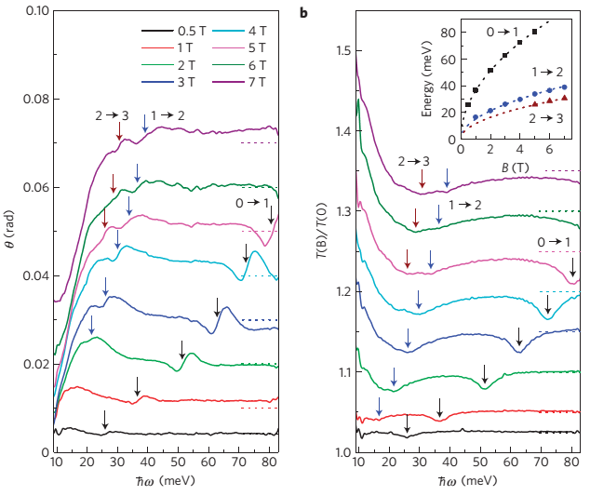
Landau Level transitions in MLG (on SiC)
Unlike single layer graphene,
multilayer graphene are less doped and fall in
the quantum regime CR→ LL transitions
Positive slope indicates
The observed LL transition
Involves electron like states.

Slide 20
Summary
Cyclotron resonance is powerful for determining effective mass in semiconductors and estimate carrier mobility
Faraday Rotation is the optical analogue of Hall effect and is enhanced around cyclotron resonance
FTIR based CR and FR extends traditional measurements to much broader frequency range
Thanks for your attention!

Slide 21
