Slide 1
Thermodynamics of Amorphous Solids
Time Dependent Heat Capacity

Slide 2
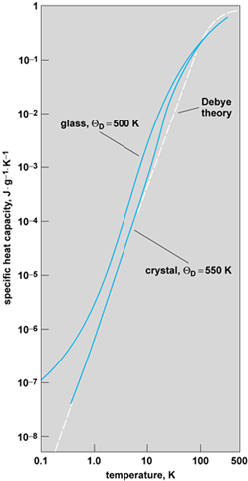
Crystalline material ~ αT³
Amorphous material ~ αT + βT³

Slide 3
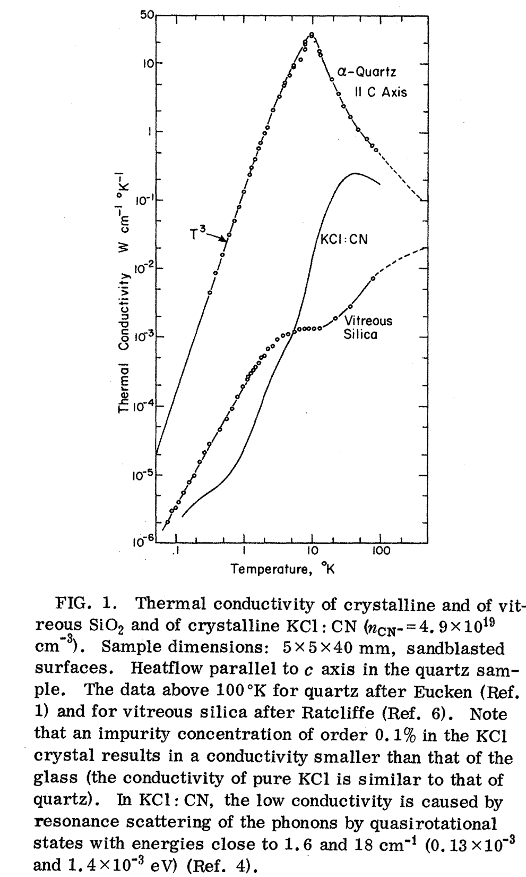
Thermal Conductivity
Crystalline dielectric ~ αT³
Amorphous dielectric ~ αT²

Slide 4
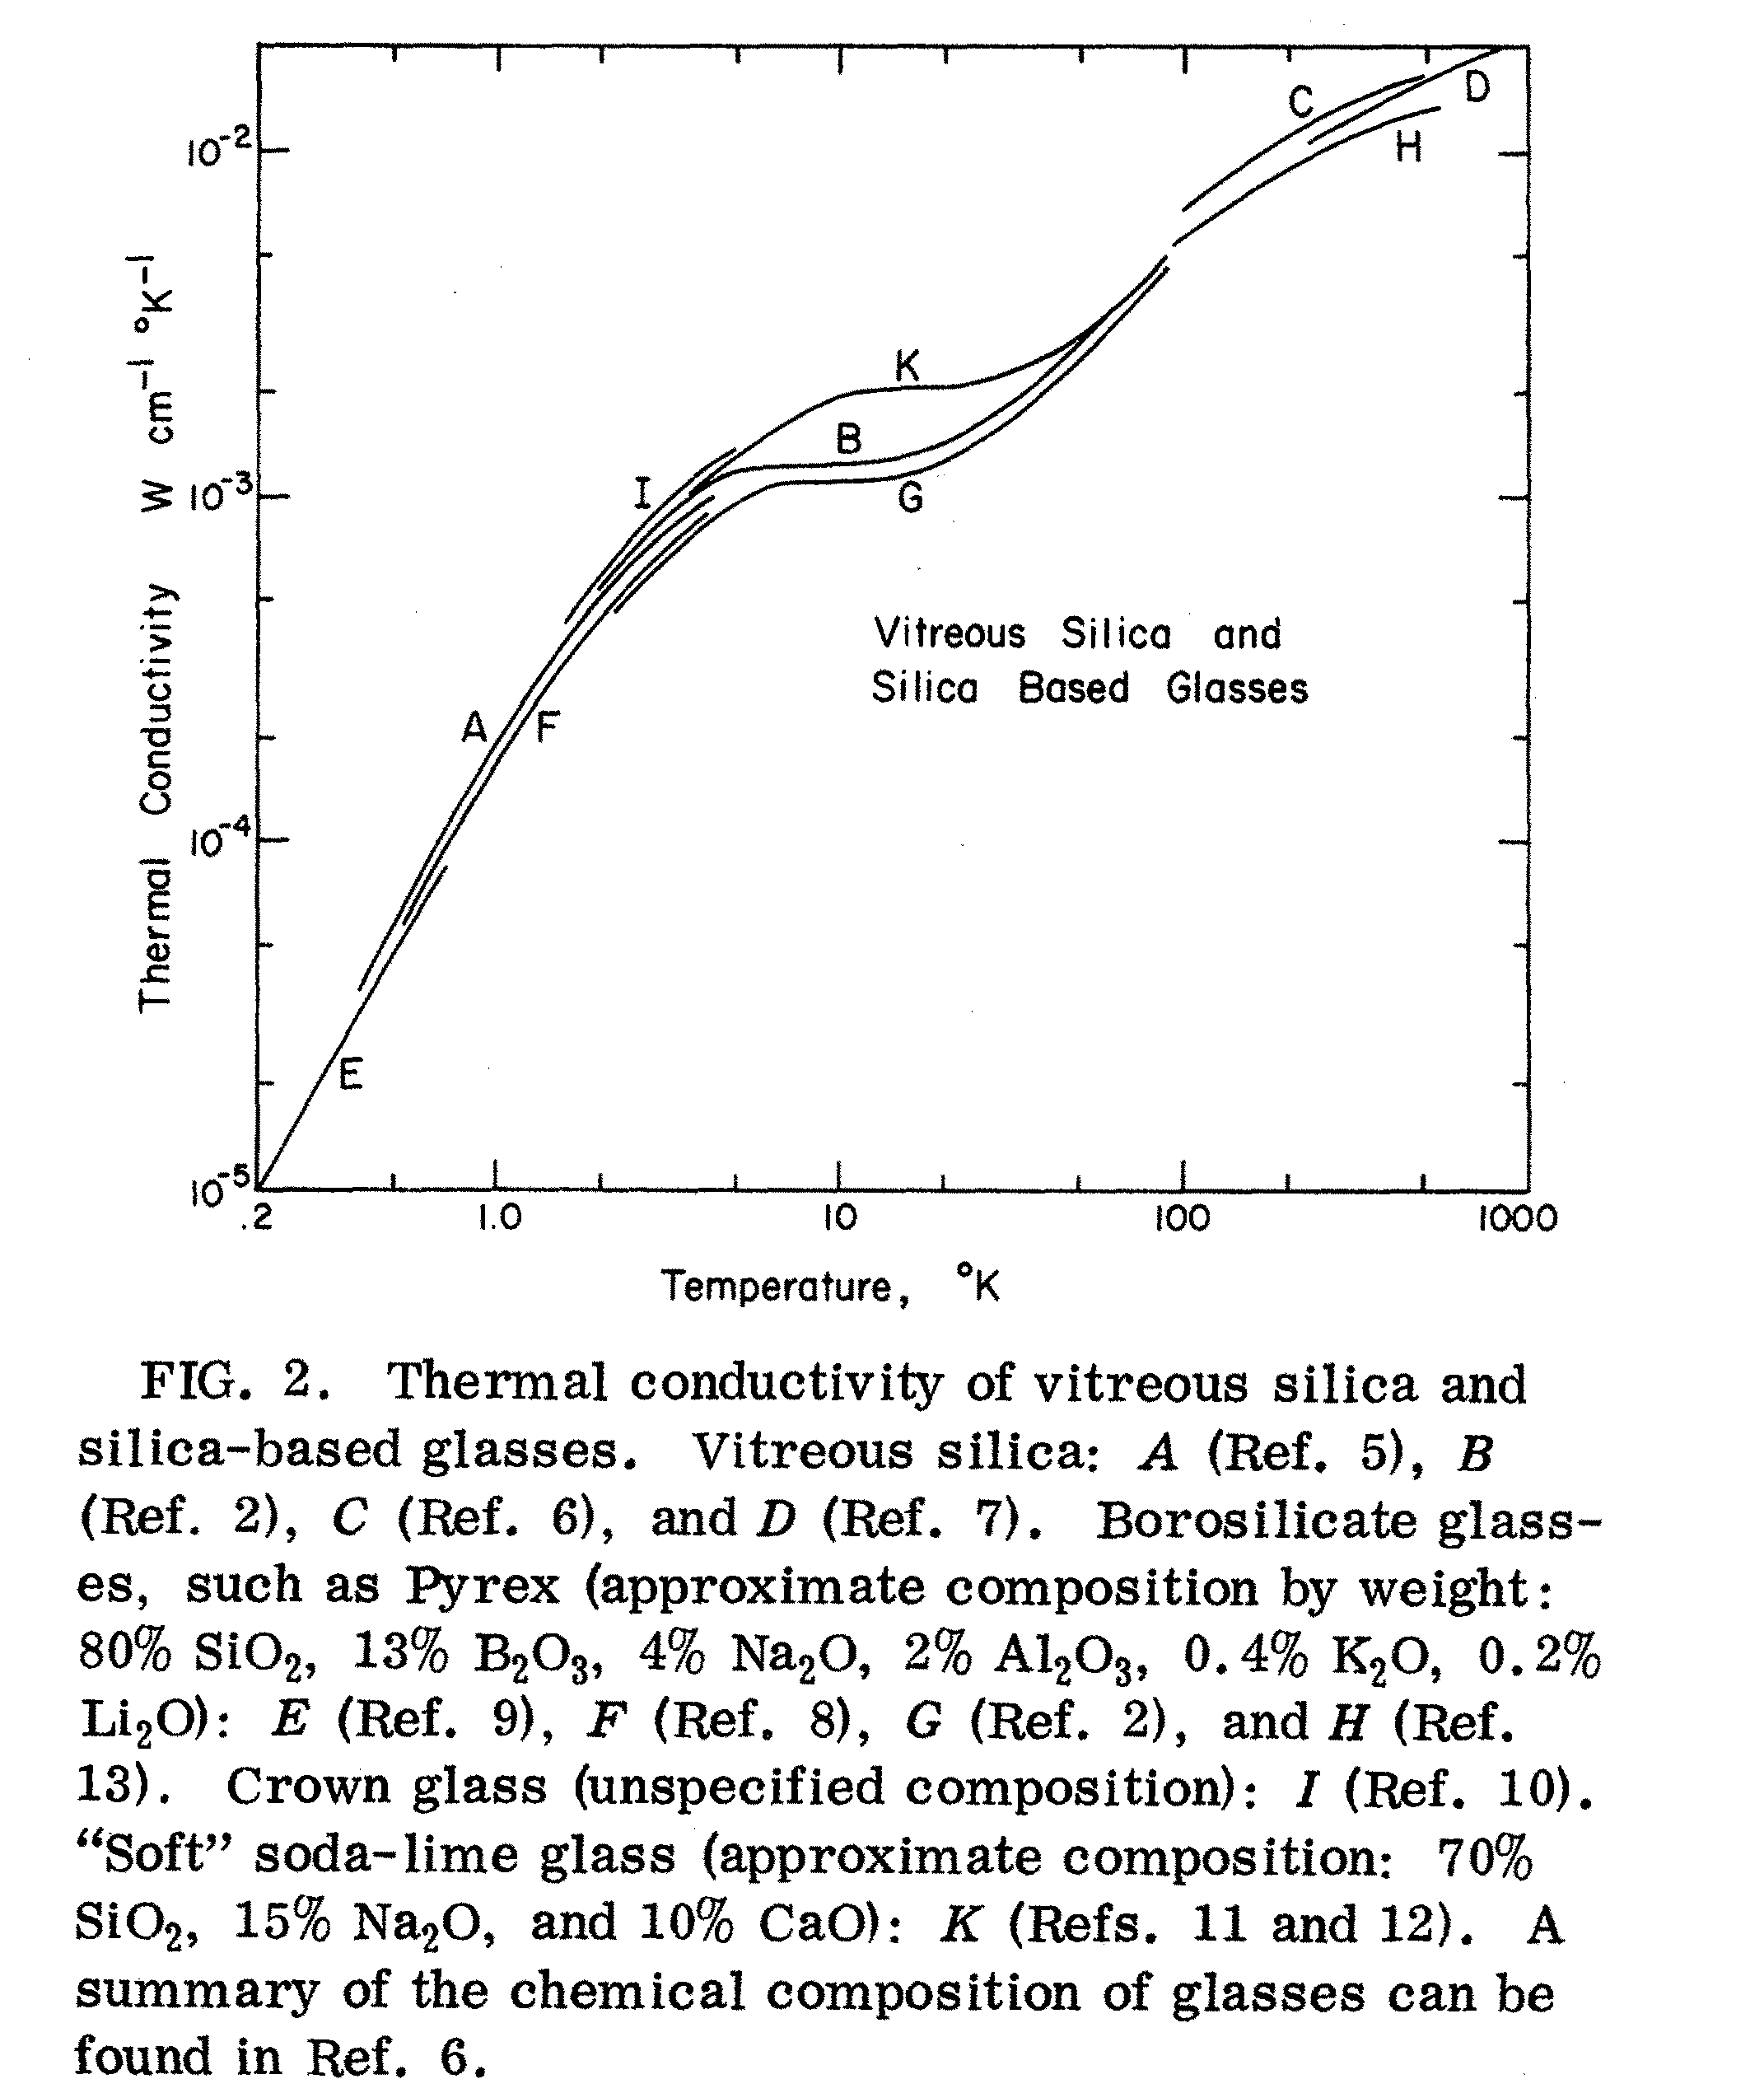

Slide 5
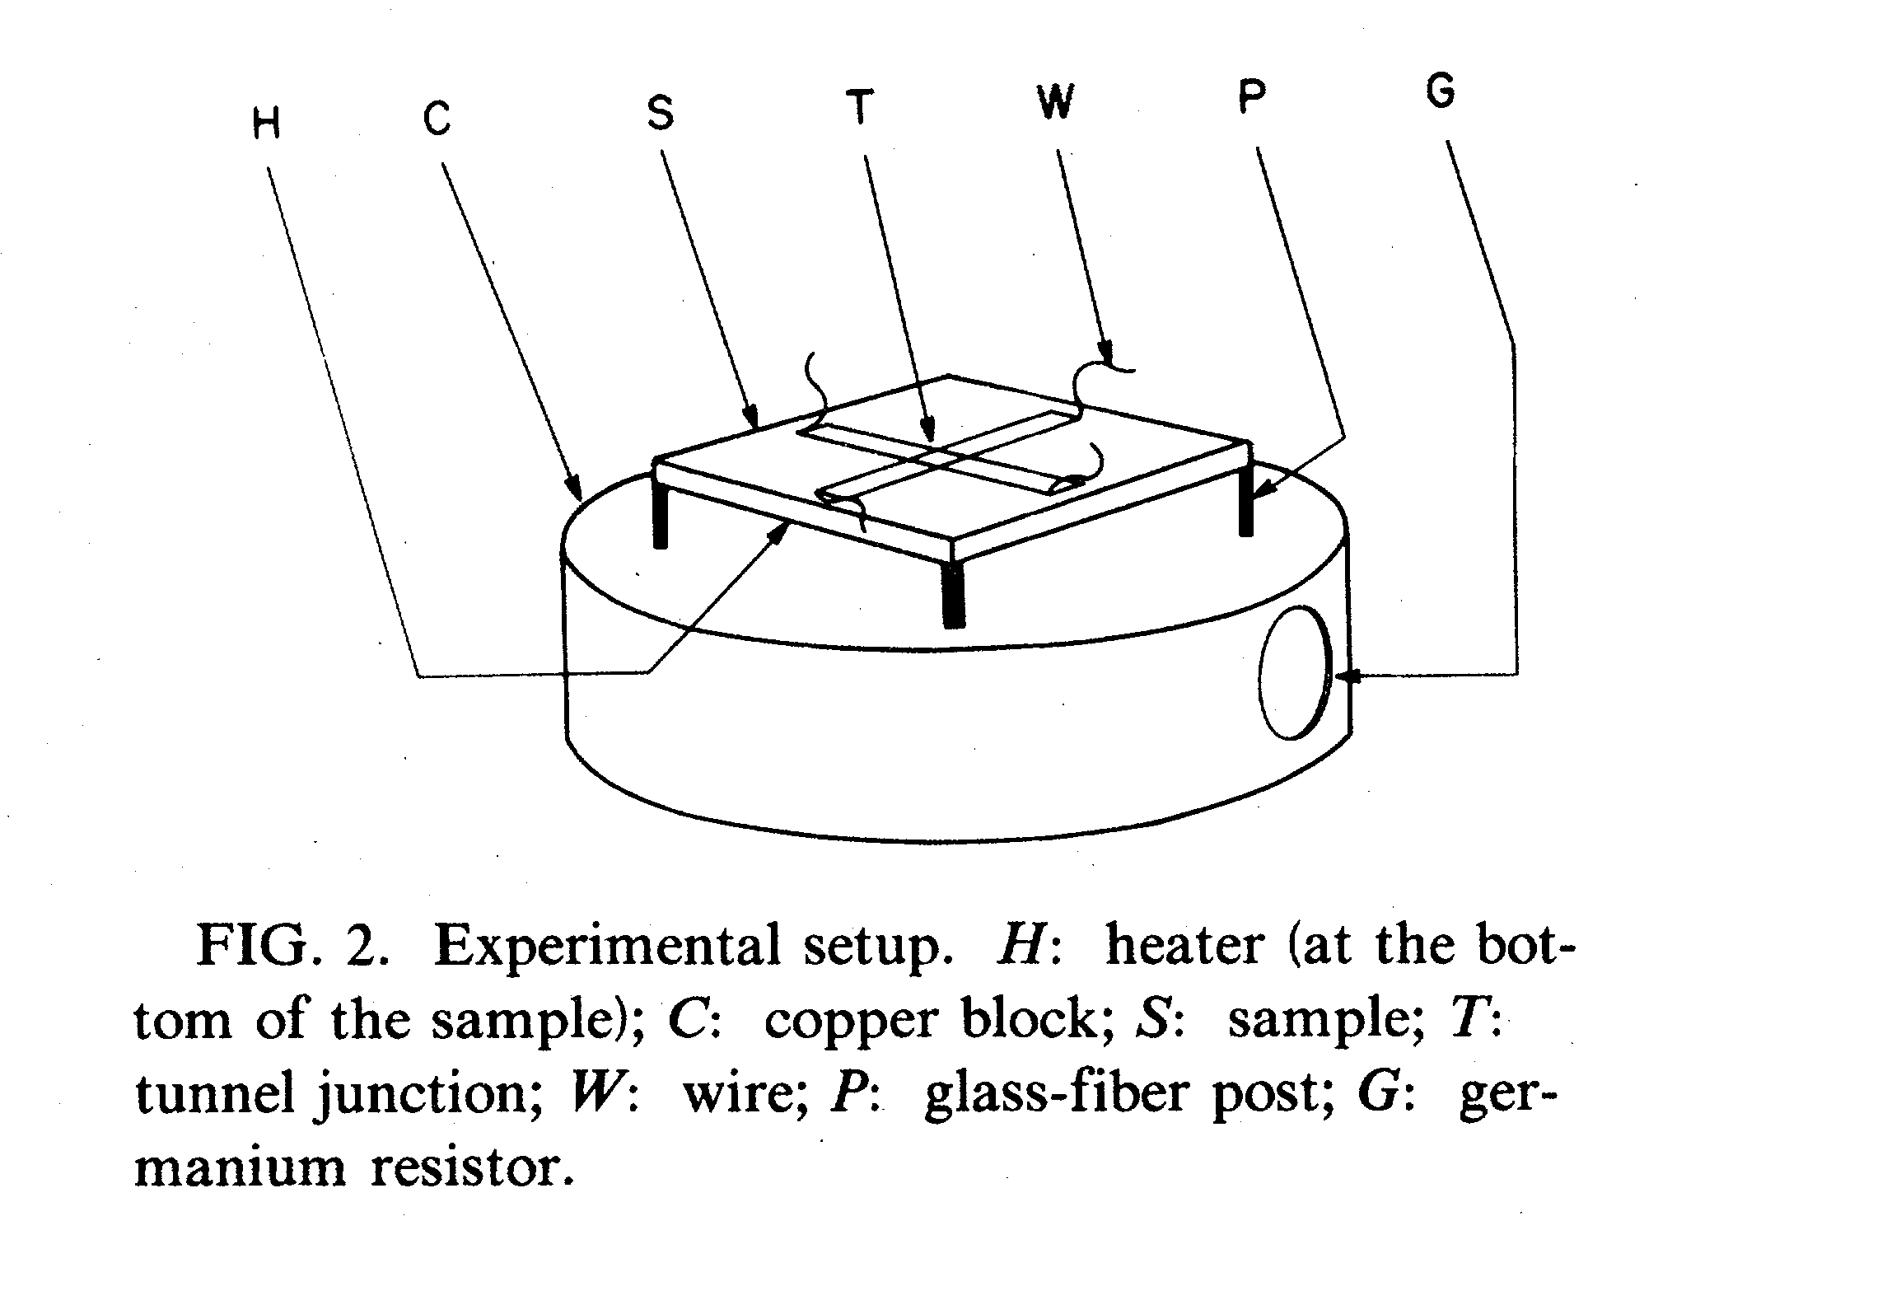

Slide 6
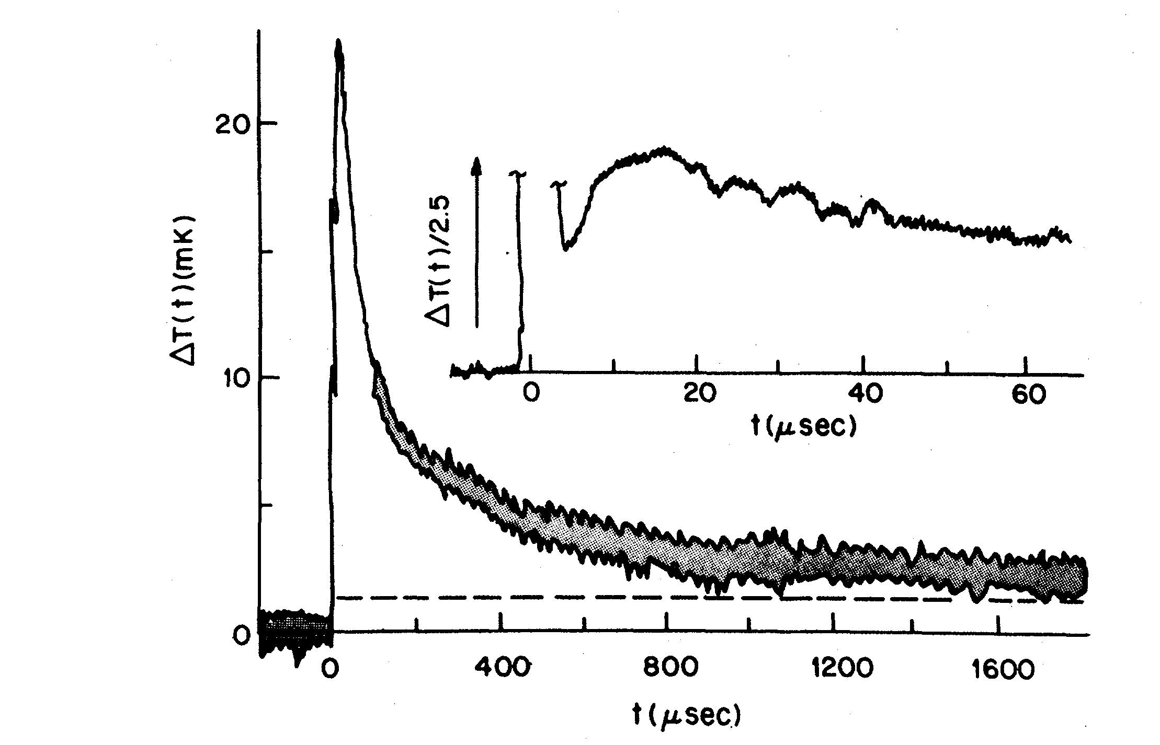

Slide 7
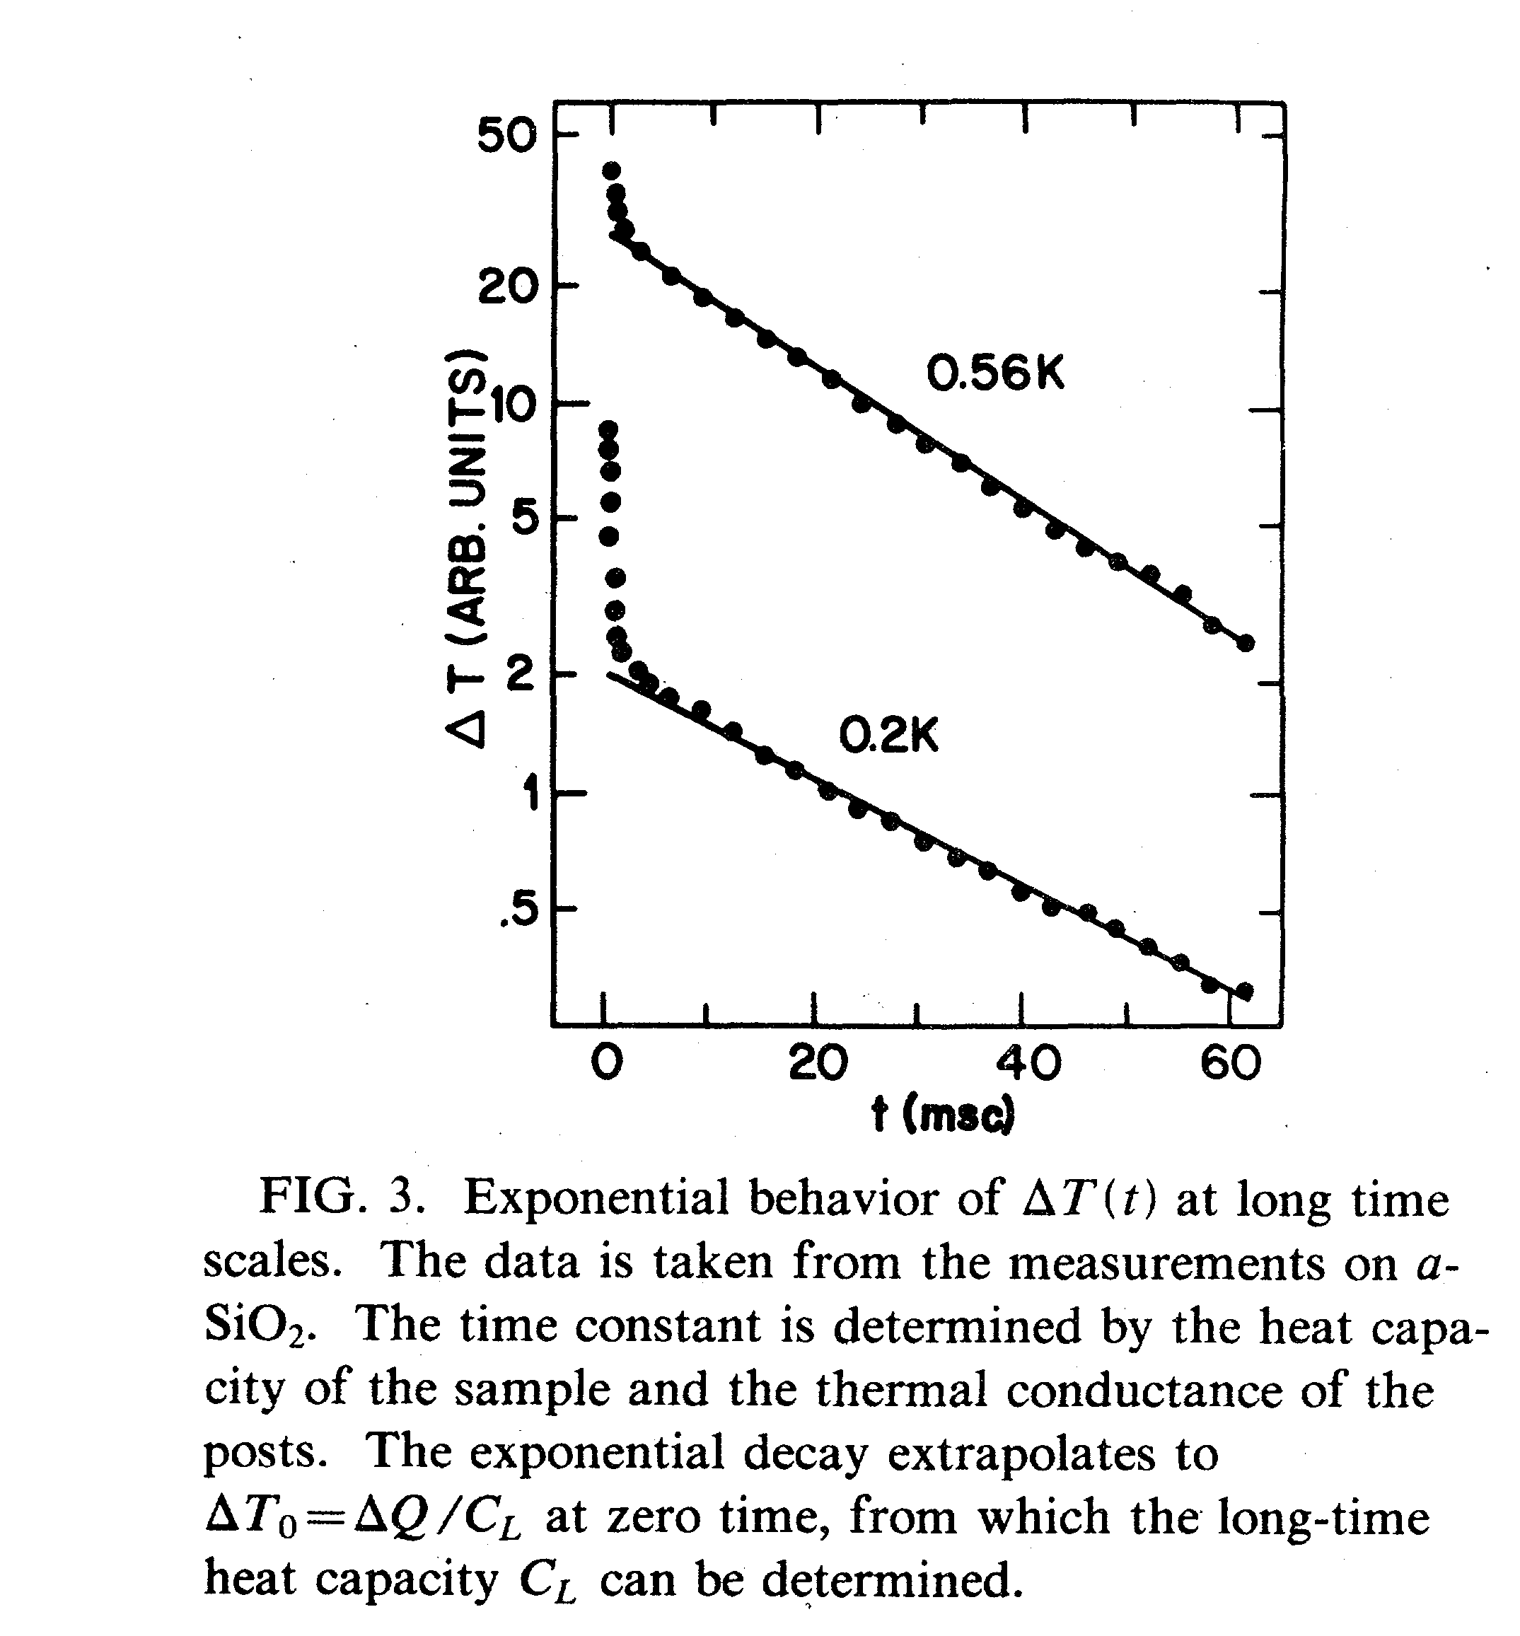

Slide 8
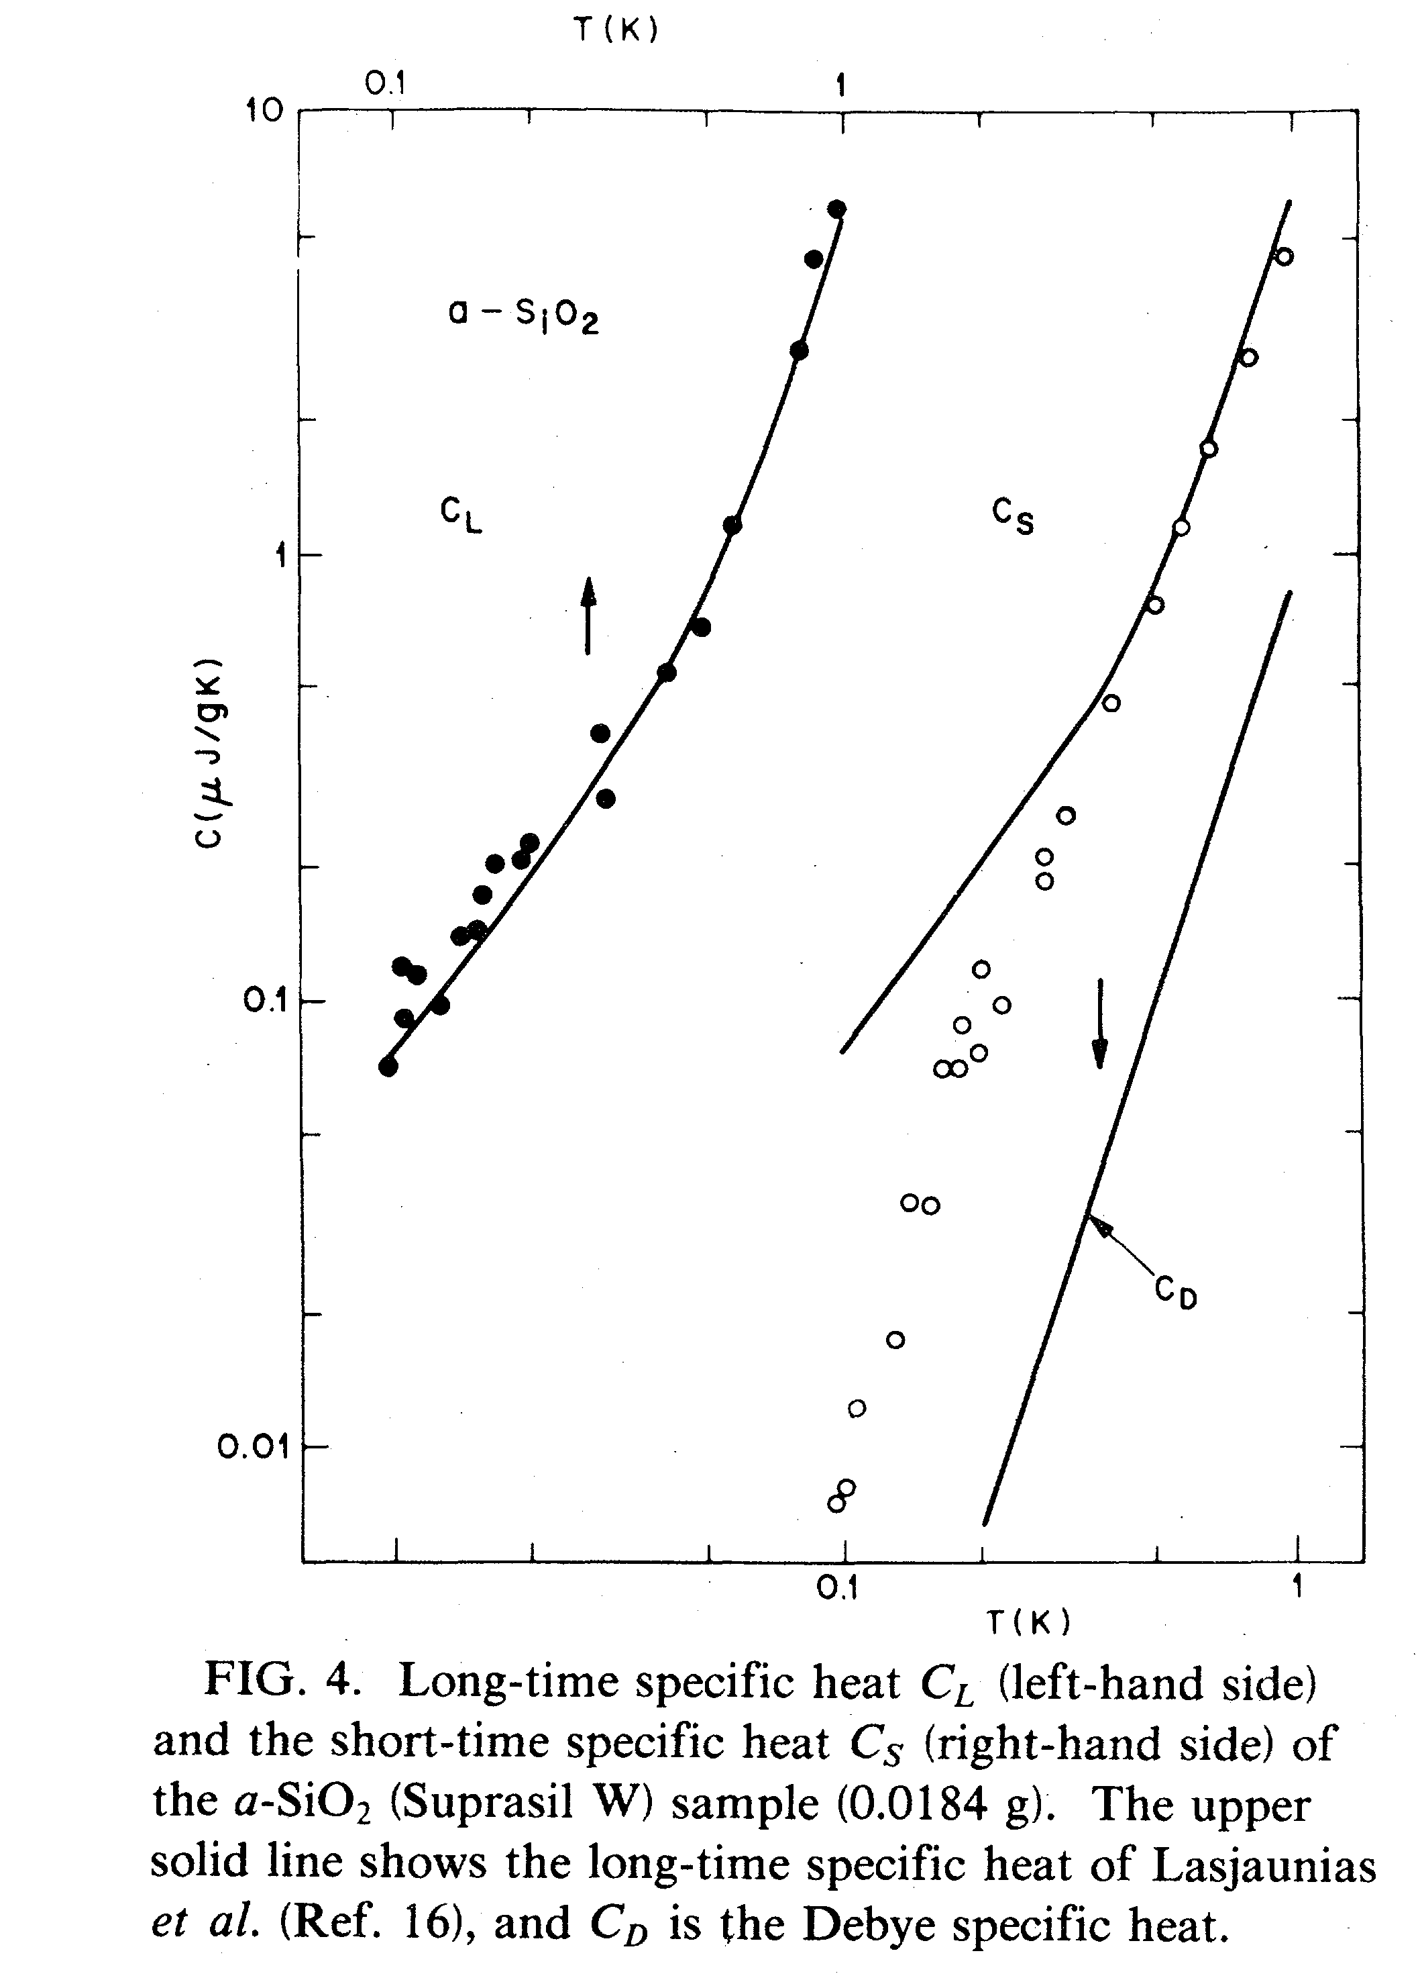

Slide 9
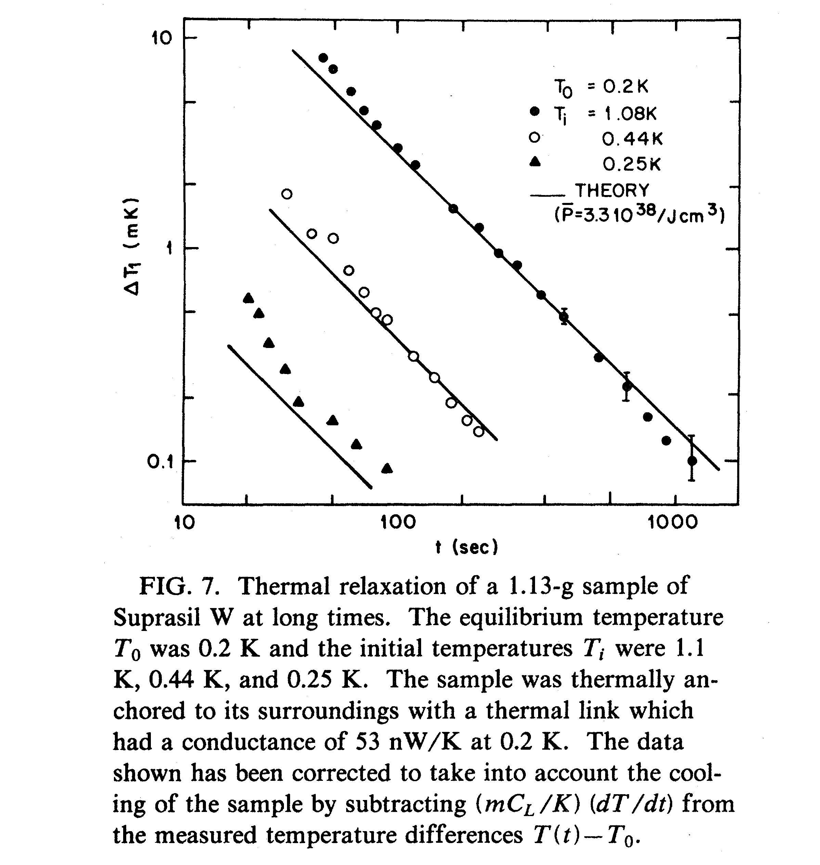

Slide 10
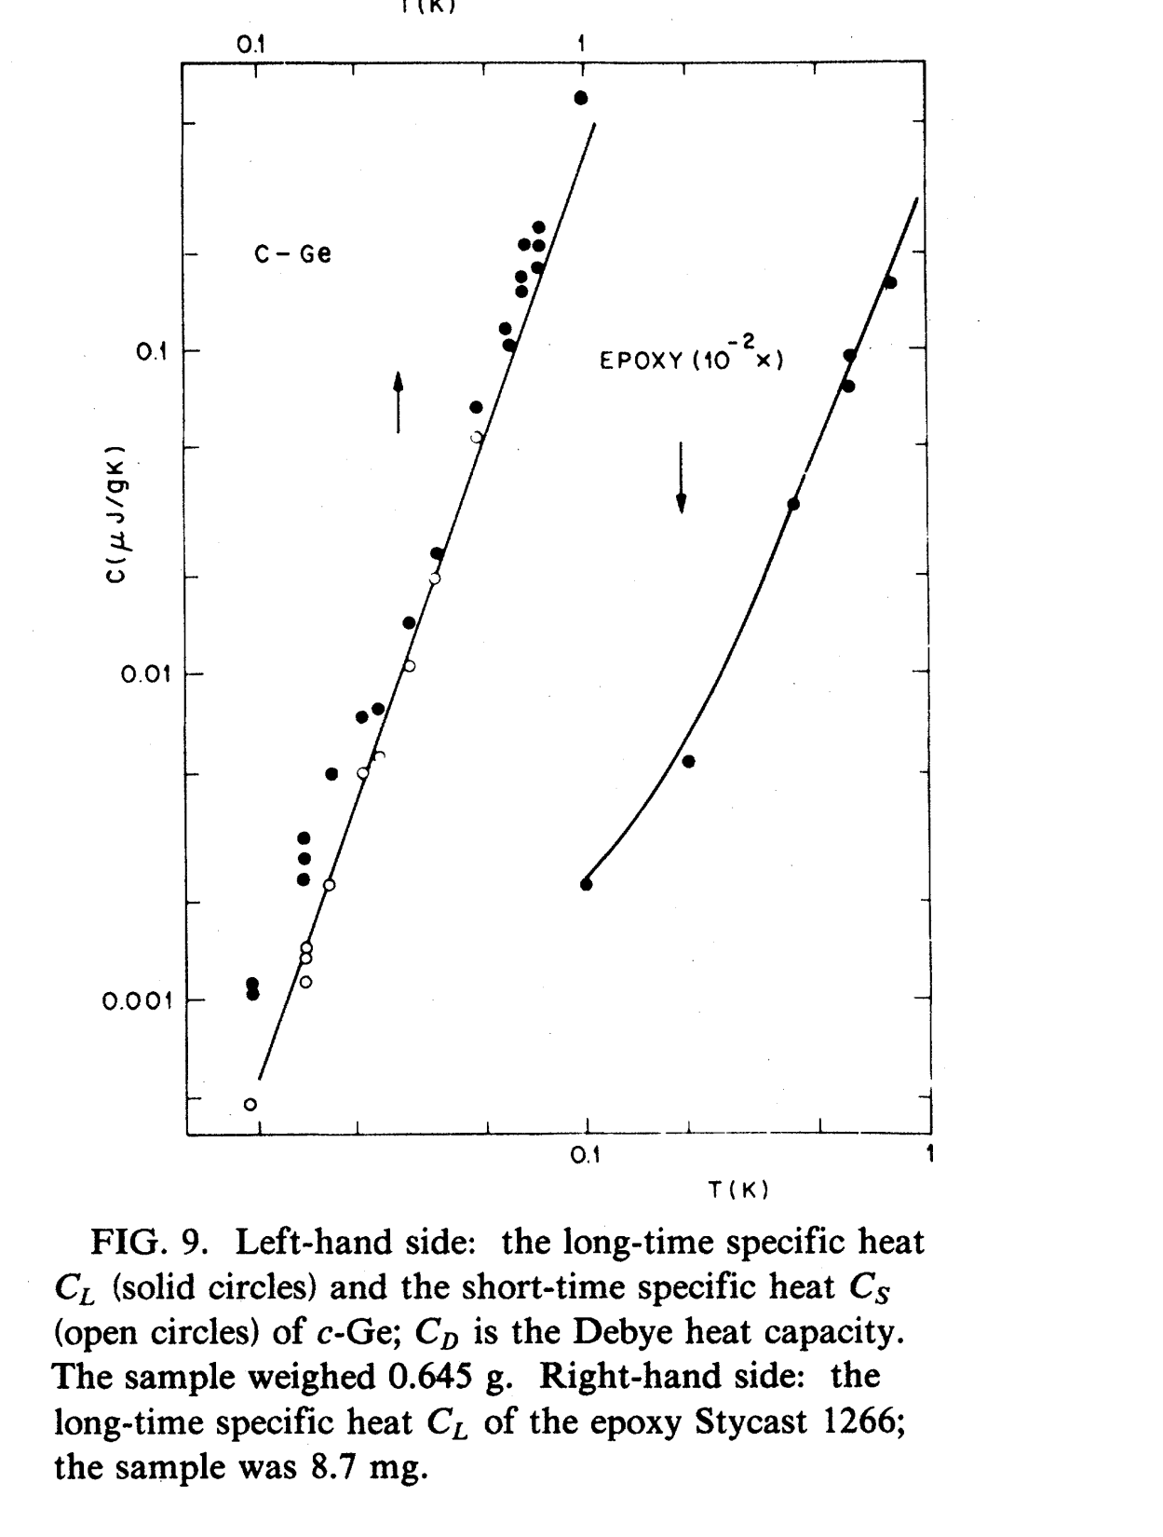

Slide 12
