Slide 14
the harmonic approximation
the mean equilibrium position of each atom is a Bravais lattice site
typical displacements of each ion are small compared to interatomic spacing
the pair potential energy of the Lennard-Jones form
is approximated by the quadratic term
van der Waals attraction
dominating at large r
repulsion due to the
Pauli exclusion principle
dominating at small r

Slide 15
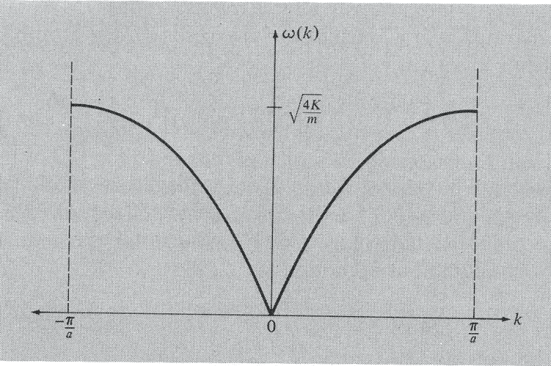
normal modes of a 1D monoatomic lattice
assume that
only
neighbor
atoms
interact
(n – 1)a na (n + 1)a u(na) is displacement of atom about na
force from left spring
force from right spring
dispersion of waves
propagating along the chain
if k is changed by
m2π/a
u(na,t) does not change
covers all independent values of k
k and k + m2π/a are equivalent
periodic boundary conditions for N atoms
allowed values of k
there are N values of k that yield distinct solutions

Slide 16
the group velocity – the transmission
velocity of a wave packet,
the velocity of energy propagation
long wavelength limit
sound velocity
standing wave

Slide 17
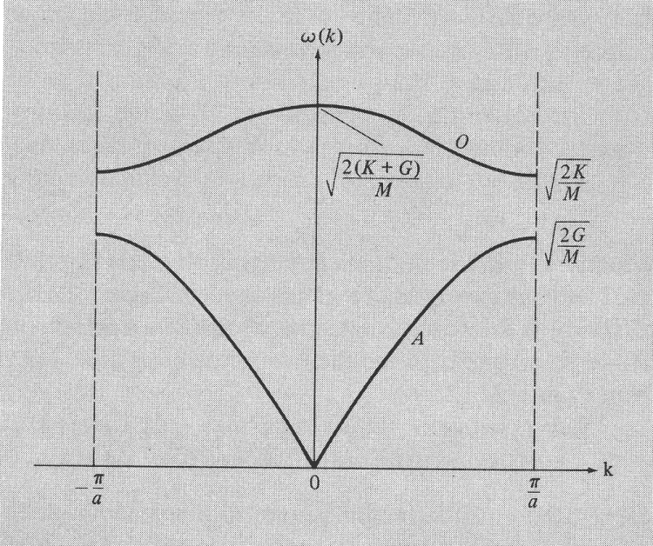
optical
branch
normal modes of a 1D lattice with a basis
G – spring
K – spring
acoustic
branch

Slide 18
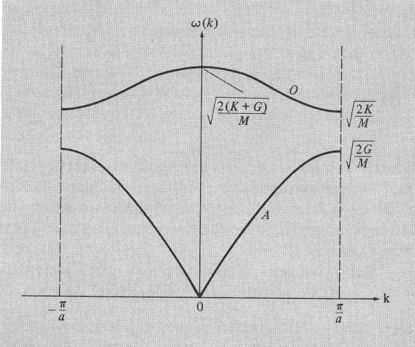
acoustic
cell
optical
the motion of primitive cells is identical
acoustic
optical
the motion changes by 180⁰ from cell to cell
in the acoustic mode the atoms within a cell move together
in the optical mode the atoms within a cell move 180⁰ out of phase

Slide 19
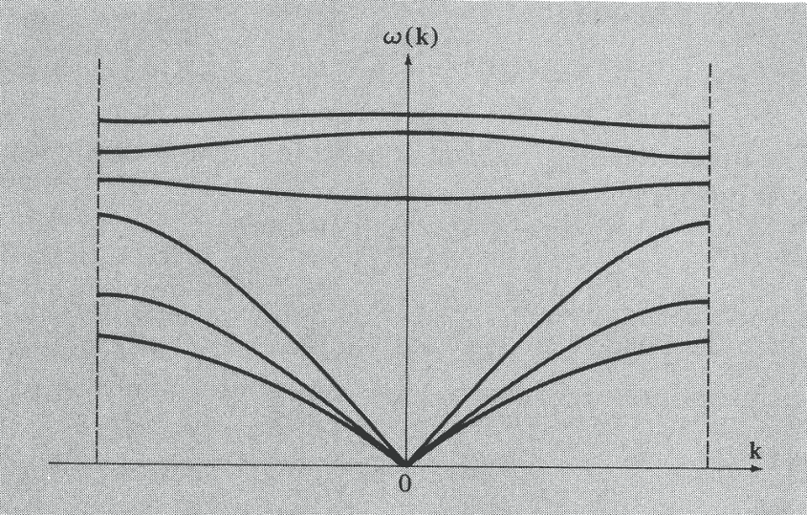
phonons
ω_{ks}
vibration of N-ion harmonic crystal correspond to
3N independent oscillators whose frequencies are
those of the 3N normal modes
energy vibrations are quantized:
ω_{ks} can have only the discrete set of values
n_{ks} = 0, 1, 2 … is the excitation number of the normal mode
LO
TO
LA
TA
TA
equivalent corpuscular description of the normal modes:
phonon – the quanta of the ionic displacement field
the normal mode of branch s with wave vector k is in its n_{ks}th excited state
there are n_{ks} phonons of type s with wave vector k present in a crystal
thermal vibrations in a crystal are thermally excited phonons
similar to photon – the
quanta of the radiation field

Slide 20
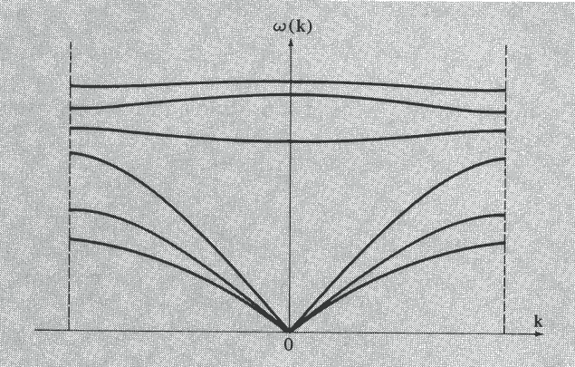
ω_{ks}
lattice specific heat
LO
energy of n_{s}(k) phonons of
type s with wave vector k
TO
LA
TA
TA
number of phonons of type s with
wave vector k at temperature T
the Planck distribution
= BE distribution with μ = 0
the energy density of a harmonic crystal
the specific heat of a harmonic crystal
high temperature specific heat
the classical law of Dulong and Petit
additional terms in the expansion yield the high-temperature quantum corrections to the Dulong and Petit law

Slide 21
specific heat at low temperatures
ω_{ks}
ω_{ks}
the Debye model:
1. all branches of the vibrational
spectrum are replaced with 3
branches with ω = ck
2. the integral over the 1st Brillouin
zone is replaced by an integral
over a sphere of radius k_{D} chosen
to contain N allowed wave vectors
LO
ω = ck
TO
LA
TA
TA
k
k_{D}
volume in k-space per
wave vector is (2π)³/V
for N atoms
integration over the
1st Brillouin zone
Debye frequency
Debye temperature – a measure of the temperature above which all modes
begin to be excited, and below which modes begin to be “frozen out”

Slide 22
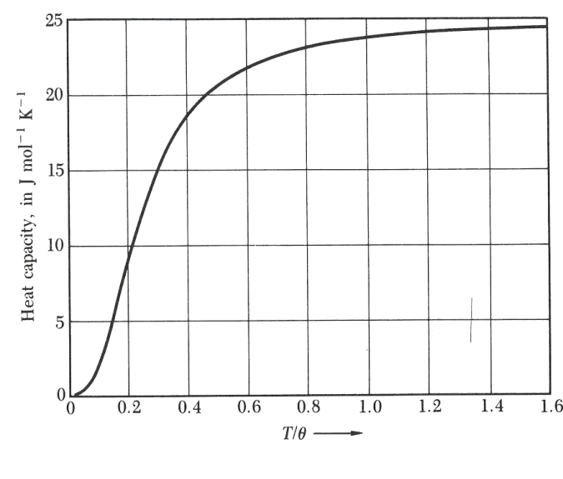
phonon density of states
without equilibrium
energy and the energy of
the zero-point vibrations
at low temperatures c_{v} ~ T³
at low temperatures T << Θ_{D}
fit to T³ at low temperatures → Θ_{D}
Θ_{D}, K
Li 400
Na 150
K 100
at low temperatures c_{v} ~ T³
at high temperatures c_{v} ~ 3nk_{B} Dulong an Petit result
the Debye temperature plays the same role in the theory of lattice vibrations
as the Fermi temperature plays in the theory of electrons in metals

Slide 23
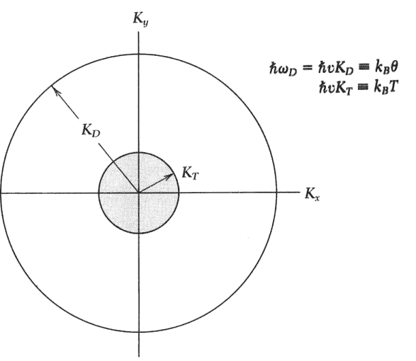
understanding T ³ law
suppose that
all phonon modes with wavevector less than k_{T}
have the classical thermal energy k_{B}T
and modes with k > k_{T} are not excited
of the 3N possible modes, the fraction excited is
the energy density is
and the specific heat is

Slide 24
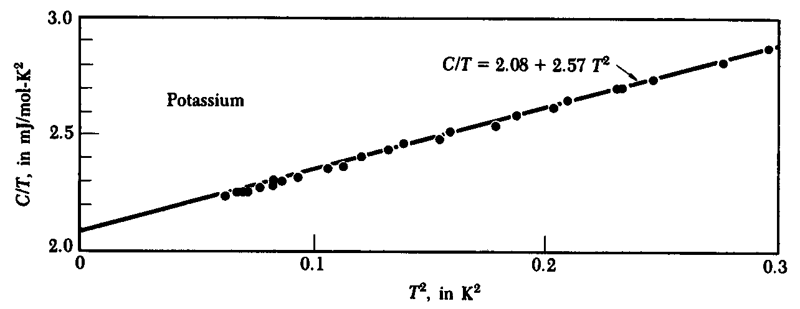
the phonon contribution to specific heat
the electronic contribution to specific heat
contributions to specific heat
electrons phonons
c_{electron} ≈ c_{phonon} at
~ a few degrees Kelvin

Slide 25
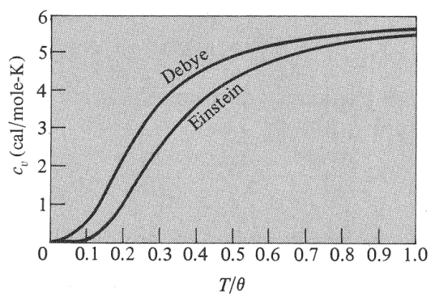
the Einstein model
the Einstein approximation replaces the frequency of each optical branch by a frequency ω_{E}
each optical branch will contribute to the thermal energy density and to the specific heat
at low T the contribution of the optical modes to c_{v} drops exponentially
it is difficult to excite thermally optical modes at low T

Slide 61
Transverse
Longitudinal

